Slide 1


MEDICS PORTAL
DEPARTMENT OF COMPUTER SCIENCE AND ENGINEERING
BY
Group No. 34 (MAJOR PROJECT)
I. HEMANT SINGH (2003630100063)
II. MAHAJBEEN PARVEEN (2003630100087)
III. HIMANSHU KUMAR SHARMA (2003630100066)
B.TECH (CSE)
Under Guidance of
Dr.Jitendra Kurmi
Assistant Professor

Slide 2
DEPARTMENT OF COMPUTER SCIENCE AND ENGINEERING
INTRODUCTION & FEATURES :
I. Overview:
- The ambulance booking service is designed to provide swift, reliable, and accessible emergency medical
transportation.
II. Purpose:
- To bridge the gap between emergency medical needs and timely response, ensuring better patient outcomes.
III. Scope:
- This service caters to various emergencies, non-emergencies, and scheduled medical transportation.
IV. 24/7 Availability:
- Round-the-clock service ensuring immediate assistance at any hour.

Slide 3
DEPARTMENT OF COMPUTER SCIENCE AND ENGINEERING
V. Emergency and Non-Emergency Services:
- Handling both urgent emergencies and scheduled non-emergency medical transportation.
VI. User Satisfaction:
- High-quality service leading to better user experiences.
VIII. Medical Coordination:
- Coordination with hospitals and healthcare facilities for a smooth patient handover.
IX. User-friendly Interface:
- Intuitive app and website design for easy navigation and quick booking.
X. Feedback System:
- Mechanism for users to provide feedback and rate their experience for continuous improvement.

Slide 4
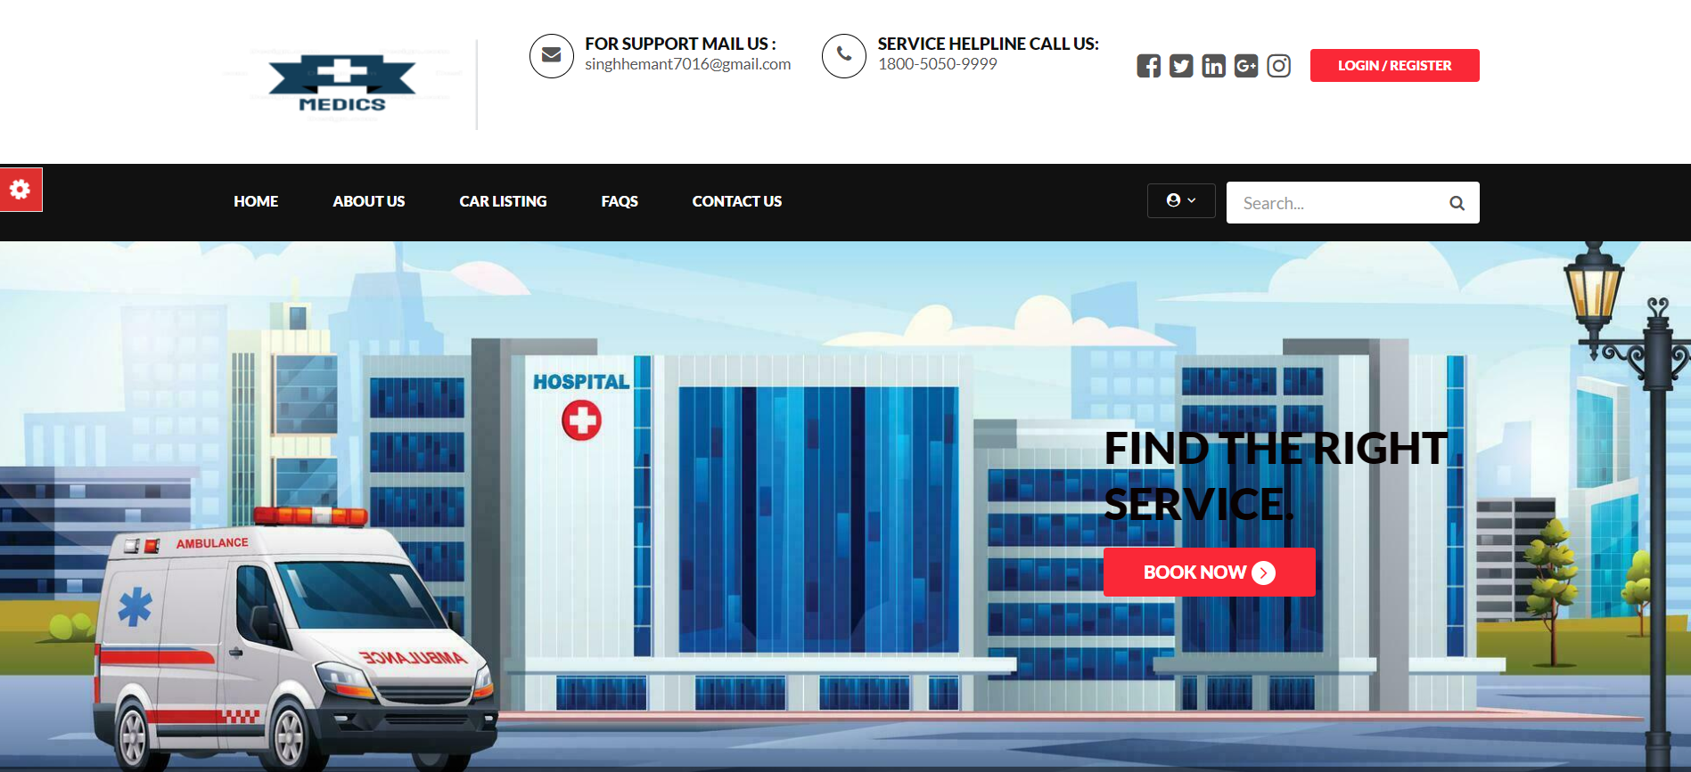
HOMEPAGE
DEPARTMENT OF COMPUTER SCIENCE AND ENGINEERING
- Login/ Register
The user login and registration feature ensures secure access by verifying user identity. It allows new users to create accounts, encrypts passwords for protection, and provides account management for updating personal information.
- Quick Selection
Choose From the available categories:
- Basic & Emergency

Slide 5
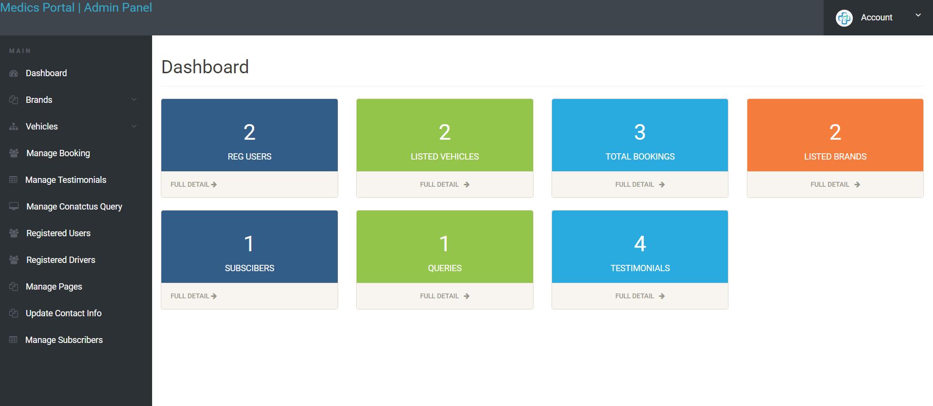
ADMIN LOGIN:
DEPARTMENT OF COMPUTER SCIENCE AND ENGINEERING
The admin section in the Medics Ambulance Booking Portal allows administrators to manage bookings, user accounts, and ambulance availability efficiently. It includes features for monitoring system performance, generating reports, and ensuring smooth operation of the ambulance services.

Slide 6
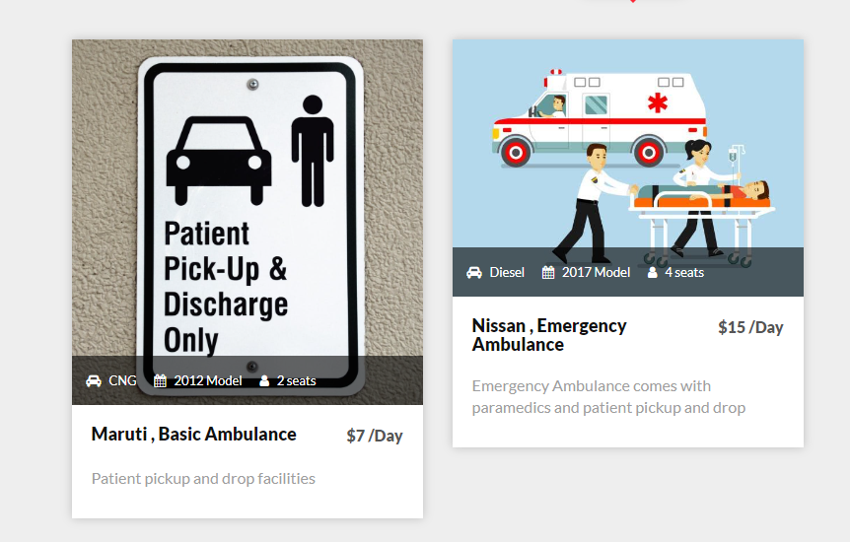
LISTINGS
DEPARTMENT OF COMPUTER SCIENCE AND ENGINEERING
- Basic Ambulance :
The basic ambulance section in Medics Ambulance Booking Portal manages standard ambulance services, ensuring prompt and reliable bookings for users.
- Emergency Ambulance:
The emergency ambulance section in Medics Ambulance Booking Portal prioritizes urgent bookings, ensuring rapid response and immediate medical attention.

Slide 7
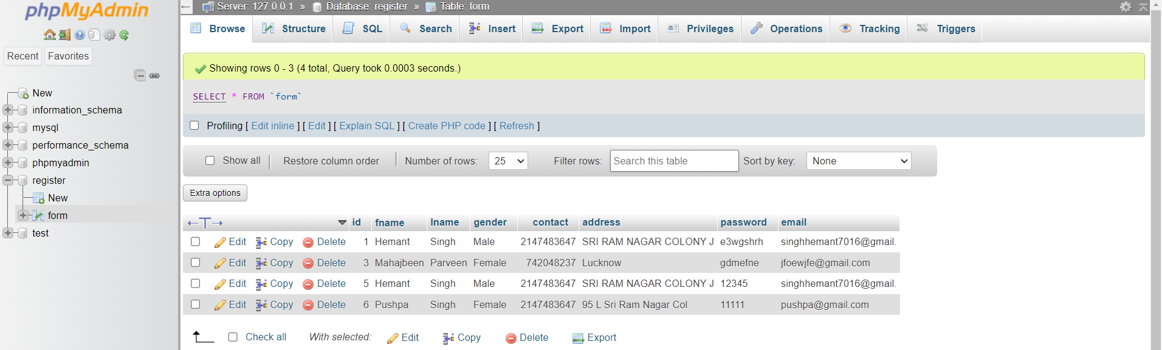
DATABASE
DEPARTMENT OF COMPUTER SCIENCE AND ENGINEERING
-MySQL:
The MySQL section in the Medics Ambulance Booking Portal handles database management, storing user information, booking details, and ambulance data, ensuring efficient, secure, and organized data retrieval and storage.
- Xampp Server:
Data is stored in XAMPP server, a local web server solution, facilitating database management, website development, and testing in a self-contained environment.

Slide 8
TECHNOLOGIES USED
DEPARTMENT OF COMPUTER SCIENCE AND ENGINEERING
HTML : - HTML employs tags to structure content, defining elements like headings, paragraphs, links, images, forms, tables, and multimedia for webpages.
CSS :
- CSS style elements on a rental website, enhancing layout, color, typography, and responsiveness to create an appealing and functional interface.
Javascript
- JavaScript plays a crucial role in the development of an ambulance booking system, providing both client-side and server-side functionalities. Here’s how JavaScript can be utilized in different aspects of an ambulance booking system.
Database Management System:
- Use a relational database management system (RDBMS) like MySQL and PHP to store and manage property listings, user profiles, and other relevant information.

Slide 9
CONCLUSION
DEPARTMENT OF COMPUTER SCIENCE AND ENGINEERING
The ambulance booking system revolutionizes emergency medical services by providing quick, reliable, and user-friendly access to critical medical transportation. Utilizing advanced technologies like quick booking, and secure user authentication, the system ensures timely and efficient responses to medical emergencies. By integrating both client-side and server-side JavaScript, it enhances the overall functionality and user experience. This innovative solution not only improves patient outcomes but also streamlines the process of accessing emergency medical care, ultimately contributing to better healthcare delivery.

Slide 10
Benefits
DEPARTMENT OF COMPUTER SCIENCE AND ENGINEERING
24/7 Availability:
Round-the-clock service ensures that ambulances can be booked at any time of day or night.
Immediate Response:
Ensures swift and timely dispatch of ambulances, reducing response times in emergencies.
User-Friendly Interface:
Easy navigation and booking process for users of all ages and technical abilities.
Comprehensive Service:
Caters to both emergency and non-emergency medical transport, including scheduled appointments.
Professional Medical Staff:
Ensures that all ambulances are staffed with trained medical professionals for high-quality care.

Slide 11
References
DEPARTMENT OF COMPUTER SCIENCE AND ENGINEERING
Google.com
Open.ai
https://www.w3schools.com/
St. John Ambulance Service, Canada

Slide 12
DEPARTMENT OF COMPUTER SCIENCE AND ENGINEERING
THANK YOU

